Slide 1
Excel Project
Unlocking Growth Opportunities: Strategic Recommendations for Zomato's Restaurant Expansion with lesser competition

Slide 2
Introduction
This presentation provides strategic recommendations for Zomato’s restaurant expansion, aiming to unlock growth opportunities in the market. I have analyze key factors and propose actionable insights for the company’s future success.
Understanding the competitive landscape and consumer preferences is crucial for successful expansion. Analyzing market trends, customer behavior, and competitor strategies will provide valuable insights for Zomato's growth.

Slide 3
These are the suggested countries where new restaurants can be started based on the number of restaurants they have, and also mentioned the number of restaurants in that country.

Slide 4
Below are the cities in the suggested countries where a restaurant can be started with a lesser competition.

Slide 5
Before we get confused with in which country we have to start a Restaurant. Let's look at this chart,
Here, By looking at this chart we can tell that the country with the lower average rating can be the one we are looking for to start.

Slide 6
Countries | Average Expenditure of one person
Canada | USD 18.13
Qatar | QAR 111.88
Singapore | USD 77.88
Sri Lanka | LKR 1,187.50
Indonesia | IDR 1,40,595.24
Philippines | PHP 803.41
Australia | USD 12.04
Turkey | TRY 42.43
New Zealand | NZD 34.88
It is critical to understand the cost of a meal for an individual in a given nation, or alternatively, the amount that an individual is willing to spend for a meal in that nation.
This provides us with the average cost incurred by an individual in the nation to determine the pricing of the dishes in the restaurant. I Have mentioned the average Expenditure of one person In particular country and their own currency.

Slide 7
It’s also important to know who are they. And here are the top 10 Restaurants who are your competitor.
Bridge Road Brewers
Izakaya Kikufuji
Le Petit Souffle
Din Tai Fung
Heat - Edsa Shangri-La
Ooma
Sambo Kojin
Locavore
Mad Mark's Creamery & Good Eats
Silantro Fil-Mex
Understanding our competition is crucial when launching a fresh business or growing an existing one since it enables us to organize our own operations differently and better serve our clients' needs while obtaining their input.

Slide 8
Once you are aware of your competitors, it is crucial to determine which cuisines you will be serving before opening your restaurant. There are a number of elements that could influence choice of cuisine.
Italian, Deli
European, Contemporary
World Cuisine
American, BBQ, Sandwich
Hawaiian, Seafood
American, Burger, Grill
Mughlai, Lucknowi
American, Caribbean, Seafood
Sunda, Indonesian
American, Coffee and Tea
The cuisines ranked in the top ten

Slide 9
In addition to providing excellent food, we also need to consider providing basic but crucial services for our customers, such an online ordering system and a way to reserve tables.
Let's now examine how the data responds to these factors in terms of rating.

Slide 10
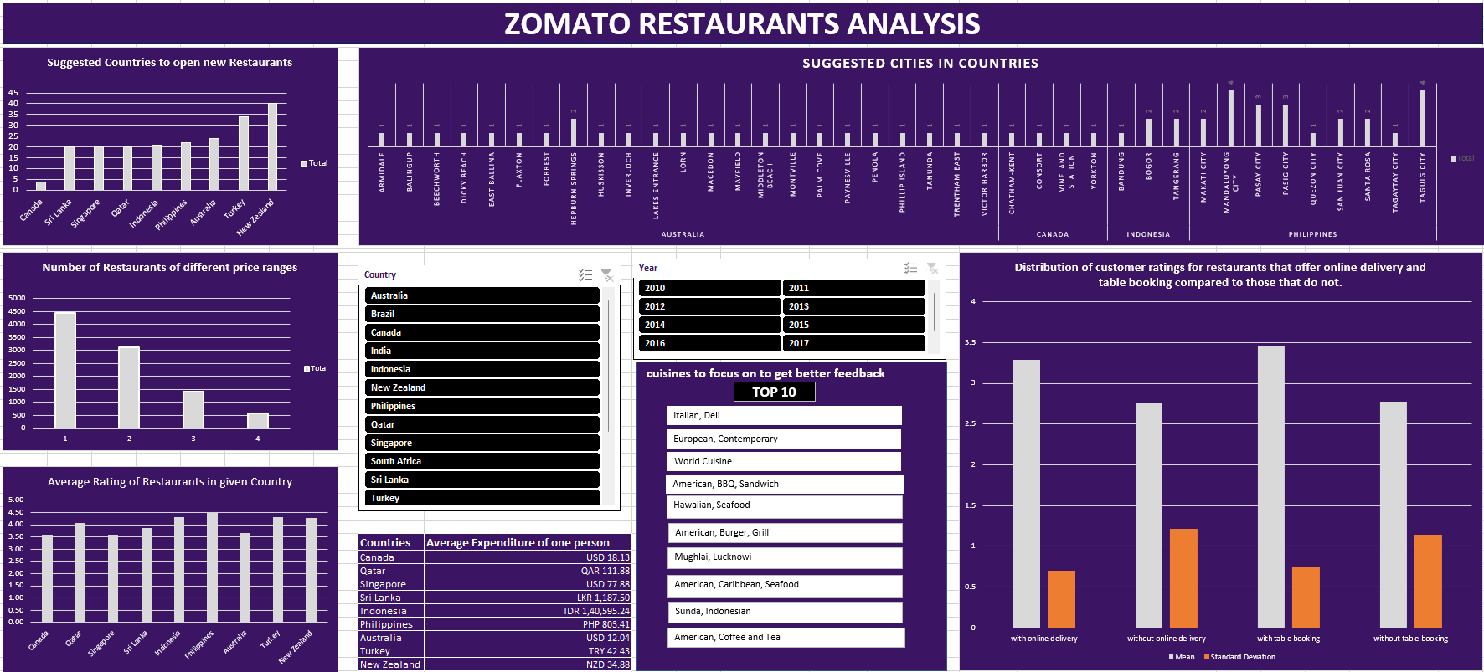
DASHBOARD

